Slide 1
Key Differences Between Ethernet and Fiber Optic Cables
Feature / Criteria | Ethernet Cable (Twisted-Pair Copper) | Fiber Optic Cable
1. Transmission Medium | Transmits data using electrical signals traveling through copper wires. | Transmits data using pulses of light traveling through thin glass or plastic strands.
2. Speed & Bandwidth | Supports standard LAN speeds (e.g., 1 Gbps to 10 Gbps for Cat6/Cat6a) over shorter ranges. | Supports massive bandwidth capabilities reaching hundreds of gigabits or terabits per second over long distances.
3. Interference & Distance | Vulnerable to electromagnetic interference (EMI); limited to a maximum run of 100 meters per segment. | Completely immune to electrical and electromagnetic interference; capable of transmitting data across kilometers with minimal signal loss.
Real-World Example for Ethernet: Connecting a desktop computer directly to a home or office Wi-Fi router via a wall jack.
Real-World Example for Fiber Optics: Connecting high-speed internet backbones between buildings across a large college campus or wide area networks (WANs).

Slide 2
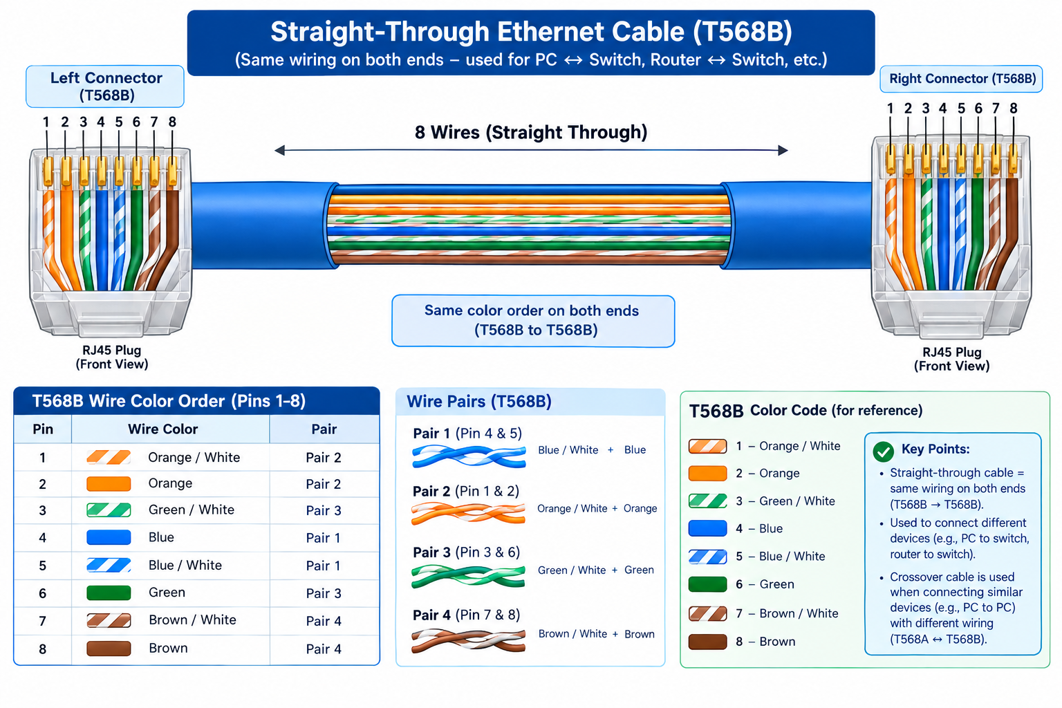
DIAGRAM

Slide 3
Step-by-Step Guide to Attach an RJ45 Connector to a CAT6 Cable
Strip the Outer Jacket: Use the wire stripper blade on your crimping tool to strip off about 1.5 to 2 inches of the outer PVC jacket of the CAT6 cable without nicking the inner wires.
Untwist and Align Wires: Untwist the four pairs of colored wires and arrange them strictly in the T568B order from left to right: White/Orange, Orange, White/Green, Blue, White/Blue, Green, White/Brown, Brown.
Trim the Wires Evenly: Hold the aligned wires tightly between your fingers and use scissors or the cutting blade of the crimper to trim the ends straight, leaving about 1/2 inch of exposed wire.
Insert into RJ45 Connector: Carefully slide the trimmed wires into the RJ45 modular plug, ensuring that each wire goes into its designated guide channel all the way to the front tip, and the outer cable jacket is tucked inside under the locking tab.
Crimp the Connector: Insert the prepared RJ45 plug firmly into the crimping tool slot and squeeze the handles tightly together until the metal pins pierce the wire insulation and lock securely into place.

Slide 4
Gaming Cafe Network Setup Scenario (10 PCs)
Chosen Cable Type: Ethernet (Cat6 Copper Cables).
Chosen Tool: RJ45 Crimper.
Justification: For a local gaming café with 10 PCs located within a single room or building, Cat6 Ethernet cables and an RJ45 crimper provide the ideal combination of ultra-low latency, stability, and affordability. Since the distances between the PCs and the central switch are well within the 100-meter limit, copper Ethernet handles high-speed multiplayer gaming perfectly without incurring the high equipment and installation costs of fiber optics.

